Slide 1
Database Systems
Lecture #1 : Introduction

Slide 2
Basic Concepts

Slide 3
Basic Definitions
Database: A collection of related data.
Data: Known facts that can be recorded and have an implicit meaning.
Database Management System (DBMS): A software package/ system to facilitate the creation and maintenance of a computerized database.
Examples:
  Oracle
  DB2 (IBM)
  MS SQL Server
  MS Access
  Ingres
  PostgreSQL
  MySQL
Database System: The DBMS software together with the data itself. Sometimes, the applications are also included.

Slide 4
Databases
Library catalogues
Medical records
Bank accounts
Stock control
Personnel systems
Product catalogues
Telephone directories
Train timetables
Airline bookings
Credit card details
Student records
Customer histories
Stock market prices
and so on…

Slide 5
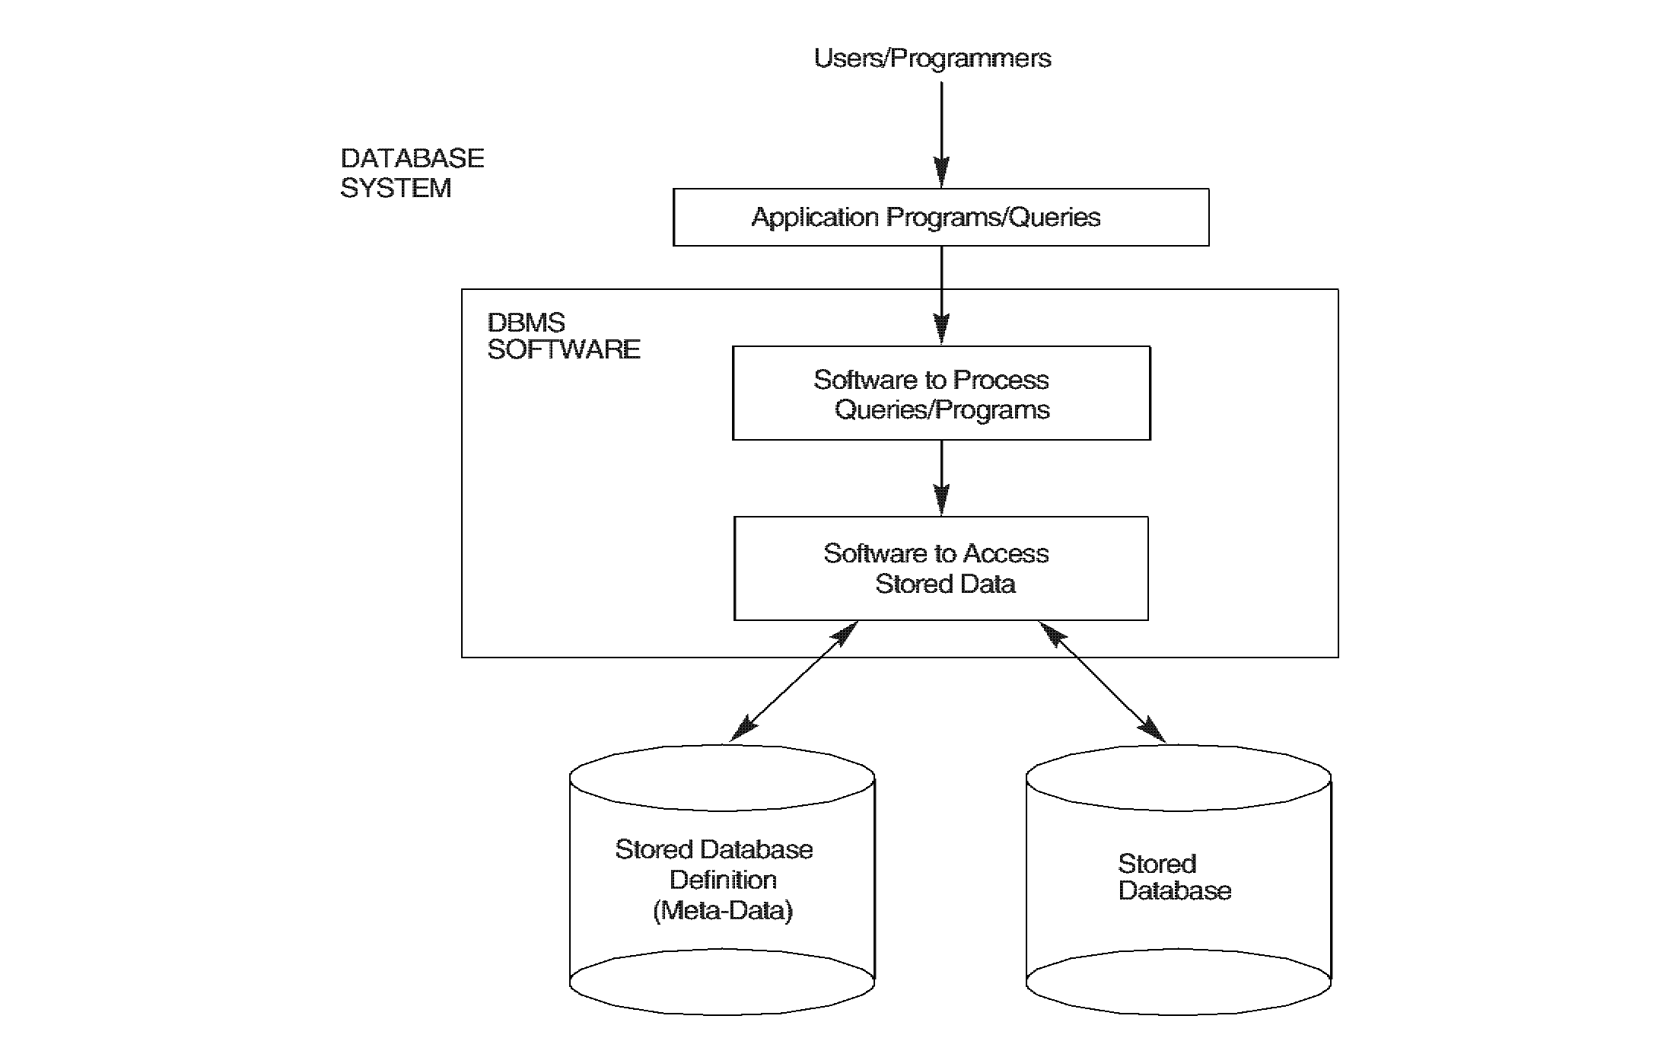
Simplified Database Systems Environment

Slide 6
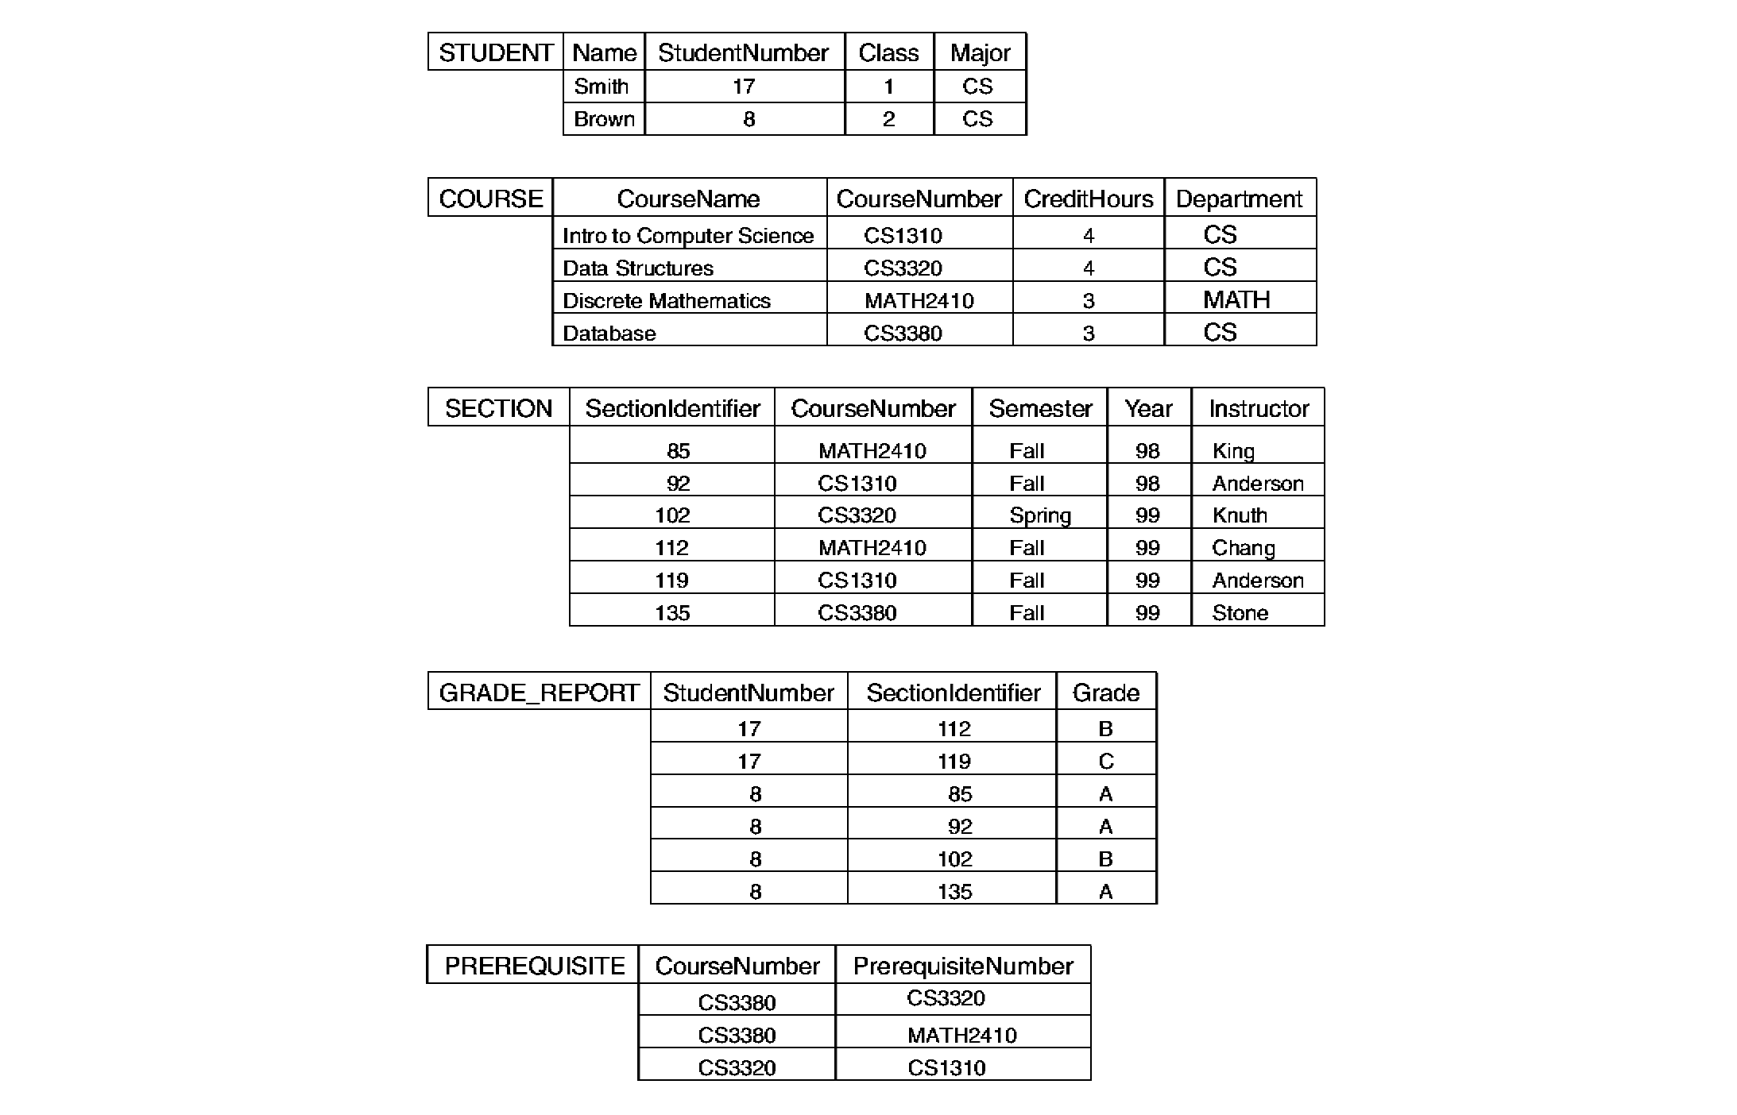
Database Example

Slide 7
File Processing Systems
Library
Examination
Registration
Library app
Examination app
Registration app
Library Data Files
Examination Data Files
Registration Data Files

Slide 8
Why Database System..?
Problems with regular file system
Separation and isolation of data
Duplication of data
Data and Program interdependence
Incompatible file formats

Slide 9
Database System Environment
Library
Examination
Registration
Library app
Examination app
Registration app
DBMS
Student Database

Slide 10
Advantages of Database System
Shared data
Reduce redundancy
Help avoid inconsistencies
Enforce integrity
Crash recovery
Data independence

Slide 11
Why not to use a DBMS?
Complexity
Cost of DBMS
Additional hardware costs
Cost of conversion

Slide 12
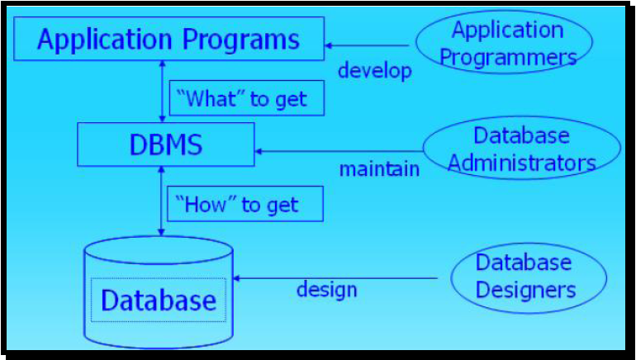
Application Programmers, Administrators and Designers

Slide 13
ANSI/SPARC Architecture
ANSI - American National Standards Institute
SPARC - Standards Planning and Requirements Committee
1975 - proposed a framework for DBs
A three-level architecture
  Internal level
  Conceptual level
  External level

Slide 14
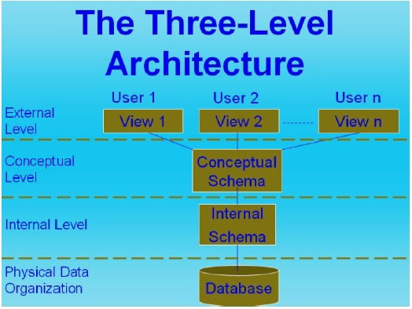
ANSI/SPARC Architecture

Slide 15
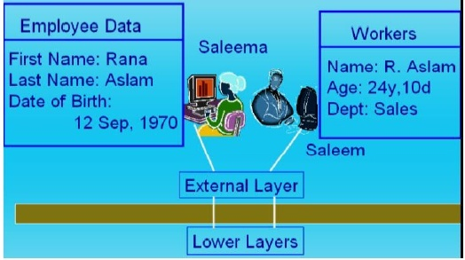
External Level
Provides a view of the database tailored to a user
  Parts of the data may be hidden
  Data is presented in a useful form
  Used by end users

Slide 16
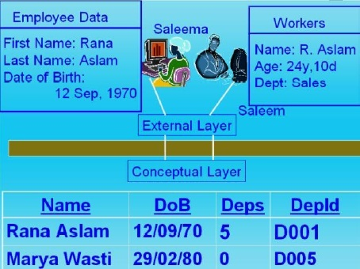
Conceptual Level
Deals with the organisation of the data as a whole
  Abstractions are used to remove unnecessary details of the internal level

Slide 17
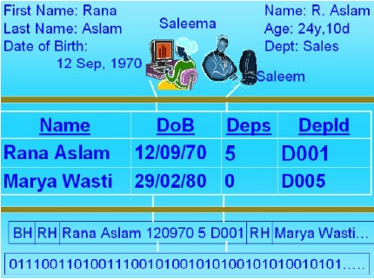
Internal Level
Deals with physical storage of data
  Structure of records on disk - files, pages, blocks

Slide 18
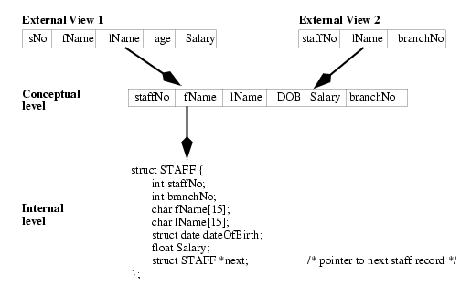
ANSI/SPARC Architecture

